Slide 1
Embedded Systems with ARM Cortex-M Microcontrollers in Assembly Language and C
Chapter 15
Timer and PWM
Exercises ANS
Z. Gu
Fall 2025
Acknowledgement: Lecture slides based on Embedded Systems with ARM Cortex-M Microcontrollers in Assembly Language and C, University of Maine https://web.eece.maine.edu/~zhu/book/

Slide 2
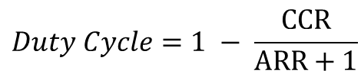

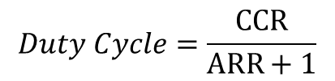
Summary of Equations
Review
Timer clock frequency $f_{CK_CNT}$ vs. CPU Clock Frequency $f_{SOURCE}$
$$f_{CK_CNT}=\frac{f_{SOURCE}}{PSC+1}$$
Timer frequency $fTimer$ with up-counting or down-counting mode:
$$fTimer=\frac{f_{CK_CNT}}{ARR+1}; Timer Period=\frac{ARR+1}{f_{CK_CNT}}= \left(ARR+1\right)∗Clock Period$$
Timer frequency $fTimer$ with center-aligned counting mode:
$$fTimer=\frac{f_{CK_CNT}}{2∗ARR};Timer Period=\left(2∗ARR\right)∗Clock Period$$
PWM duty cycle for Mode 1 (Low-True):
$$Duty Cycle=\frac{CCR}{ARR+1}$$
PWM duty cycle for Mode 2 (High-True):
$$Duty Cycle=1 − \frac{CCR}{ARR+1}$$

Slide 3
Calculating ARR
Suppose Timer Clock Frequency = 80MHz
Goal: Timer Frequency = 100Hz
What should the ARR value be for 1. up-counting mode; 2. down-counting mode; 3. center-aligned counting mode?
Notes:
{{Pause=2}} Suppose the clock source that drives the timer counter has a frequency of 80 MHz. We want to generate a SysTick interrupt every 10 milliseconds. What is the reload value? {{Pause=2}} Here is the diagram of SysTicks. {{Pause=0.5}} This is the clock signal, which has a frequency of 80 MHz. A SysTick interrupt is generated every 10 milliseconds. {{Pause=0.5}} An interrupt is generated when the counter makes the transition from 1 to 0. {{Pause=1} It takes a total of, reload plus 1, cycles to count down from the reload value to 0. {{Pause=0.5}} The reload value is calculated in this way. Reload value equals to 10 milliseconds, divided by the clock period, minus 1. This is equivalent to 10 milliseconds, multiply the clock frequency, minus 1. {{Pause=0.5}} The final result is 799999.

Slide 4

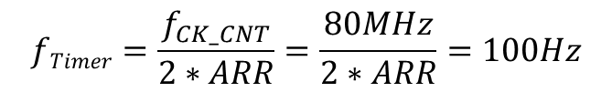

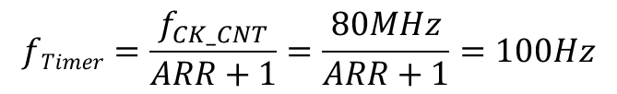
Calculating ARR ANS
Suppose Timer Clock Frequency = 80MHz
Goal: Timer Frequency = 100Hz
What should the ARR value be for 1. up-counting mode; 2. down-counting mode; 3. center-aligned counting mode?
For up-counting or down-counting mode:
For center-aligned counting mode:
$$fTimer=\frac{f_{CK_CNT}}{ARR+1}=\frac{80MHz}{ARR+1}=100Hz$$
$$fTimer=\frac{f_{CK_CNT}}{2∗ARR}=\frac{80MHz}{2∗ARR}=100Hz$$
$$ARR=799999$$
$$ARR=400000$$
But a 16-bit ARR register has value range of [0, 65535], so ARR value of 799999 or 400000 is out of range → cannot generate a 10ms timer from a 80MHz Timer Clock!
Solution: use prescaler (PSC) to reduce Timer Clock Frequency
Notes:
{{Pause=2}} Suppose the clock source that drives the timer counter has a frequency of 80 MHz. We want to generate a SysTick interrupt every 10 milliseconds. What is the reload value? {{Pause=2}} Here is the diagram of SysTicks. {{Pause=0.5}} This is the clock signal, which has a frequency of 80 MHz. A SysTick interrupt is generated every 10 milliseconds. {{Pause=0.5}} An interrupt is generated when the counter makes the transition from 1 to 0. {{Pause=1} It takes a total of, reload plus 1, cycles to count down from the reload value to 0. {{Pause=0.5}} The reload value is calculated in this way. Reload value equals to 10 milliseconds, divided by the clock period, minus 1. This is equivalent to 10 milliseconds, multiply the clock frequency, minus 1. {{Pause=0.5}} The final result is 799999.

Slide 5
Ilkustrat ARR ANS

Slide 6
Calculating ARR with prescaler
Suppose CPU Clock Frequency = 80MHz, PSC=79
Goal: Timer Frequency = 100Hz
What should the ARR value be for 1. up-counting mode; 2. down-counting mode; 3. center-aligned counting mode?
Notes:
{{Pause=2}} Suppose the clock source that drives the timer counter has a frequency of 80 MHz. We want to generate a SysTick interrupt every 10 milliseconds. What is the reload value? {{Pause=2}} Here is the diagram of SysTicks. {{Pause=0.5}} This is the clock signal, which has a frequency of 80 MHz. A SysTick interrupt is generated every 10 milliseconds. {{Pause=0.5}} An interrupt is generated when the counter makes the transition from 1 to 0. {{Pause=1} It takes a total of, reload plus 1, cycles to count down from the reload value to 0. {{Pause=0.5}} The reload value is calculated in this way. Reload value equals to 10 milliseconds, divided by the clock period, minus 1. This is equivalent to 10 milliseconds, multiply the clock frequency, minus 1. {{Pause=0.5}} The final result is 799999.

Slide 7

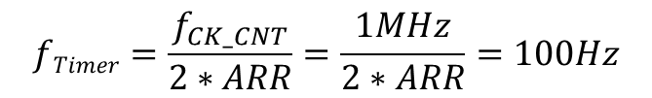

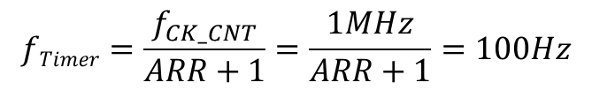
Calculating ARR with prescaler ANS
Suppose CPU Clock Frequency = 80MHz, prescaler PSC=79
Goal: Timer Frequency = 100Hz
What should the ARR value be for 1. up-counting mode; 2. down-counting mode; 3. center-aligned counting mode?
$${Timer Clock Freq f}_{CK_CNT}=\frac{f_{CK_{PSC}}}{PSC+1}=\frac{80MHz}{80}=1MHz$$
For up-counting or down-counting mode:
For center-aligned counting mode:
$$fTimer=\frac{f_{CK_CNT}}{ARR+1}=\frac{1MHz}{ARR+1}=100Hz$$
$$fTimer=\frac{f_{CK_CNT}}{2∗ARR}=\frac{1MHz}{2∗ARR}=100Hz$$
$$ARR=9999$$
$$ARR=5000$$
With prescaler, the ARR value of 9999 or 5000 is now within the range of 16-bit ARR register.
Notes:
{{Pause=2}} Suppose the clock source that drives the timer counter has a frequency of 80 MHz. We want to generate a SysTick interrupt every 10 milliseconds. What is the reload value? {{Pause=2}} Here is the diagram of SysTicks. {{Pause=0.5}} This is the clock signal, which has a frequency of 80 MHz. A SysTick interrupt is generated every 10 milliseconds. {{Pause=0.5}} An interrupt is generated when the counter makes the transition from 1 to 0. {{Pause=1} It takes a total of, reload plus 1, cycles to count down from the reload value to 0. {{Pause=0.5}} The reload value is calculated in this way. Reload value equals to 10 milliseconds, divided by the clock period, minus 1. This is equivalent to 10 milliseconds, multiply the clock frequency, minus 1. {{Pause=0.5}} The final result is 799999.

Slide 8
Calculating the ARR
Suppose a 16-bit timer has the following settings
CPU clock frequency is 4 MHz.
Prescaler PSC = 39
Counting direction: center-aligned counting
Desired timer frequency = 100 Hz
Calculate the ARR.

Slide 9
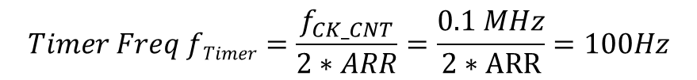

Calculating the ARR ANS
Suppose a 16-bit timer has the following settings
CPU clock frequency is 4 MHz.
Prescaler PSC = 39
Counting direction: center-aligned counting
Desired timer frequency = 100 Hz
Calculate the ARR.
${Timer Clock Freq f}_{CK_CNT}=\frac{f_{CK_PSC}}{PSC+1}$ = $\frac{4 MHz}{40}=$0.1 MHz
$$Timer Freq fTimer=\frac{f_{CK_CNT}}{2∗ARR}=\frac{0.1 MHz}{2∗ARR}=100Hz$$
$$ARR=500$$

Slide 10
Clock Frequency and Timer Frequency
Suppose all registers are 16 bits. CPU clock frequency is 400 MHz.
What is the maximum and minimum Clock Frequency, and Timer Frequency, assuming up-counting mode?

Slide 11
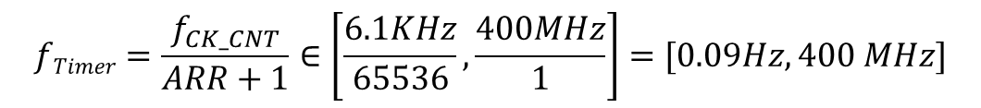
Clock Frequency and Timer Frequency ANS
Suppose all registers are 16 bits. CPU clock frequency is 400 MHz.
What is the maximum and minimum Clock Frequency, and Timer Frequency, assuming up-counting mode?
PSC, ARR are both in the range [0, 2¹⁶-1=65535].
(A realistic Timer Frequency should not be higher than 1KHz, as mentioned before.)
${ f}_{CK_CNT}=\frac{f_{CK_PSC}}{PSC+1}$=$\frac{400 MHz}{PSC+1 }∈\left[\frac{400MHz}{65536},\frac{400MHz}{1}\right]=[6.1 KHz, 400MHz]$
$$fTimer=\frac{f_{CK_CNT}}{ARR+1}∈\left[\frac{6.1KHz}{65536},\frac{400MHz}{1}\right]=[0.09Hz, 400 MHz]$$

Slide 12
PWM duty cycle
Suppose a 16-bit timer has the following settings
CPU Clock frequency is 16 MHz.
Prescaler PSC = 159
ARR = 1999
CCR = 499
Counting direction: up-counting
Output is set as PWM Mode 2 (High True).
Calculate the timer frequency and PWM duty cycle.

Slide 13
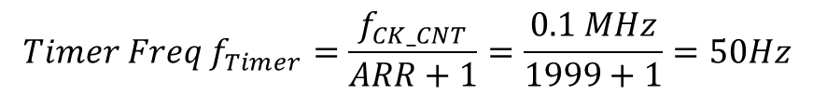
PWM duty cycle ANS
Suppose a 16-bit timer has the following setting
CPU clock frequency is 16 MHz.
Prescaler PSC = 159
ARR = 1999
CCR = 499
Counting direction: up-counting
Output is set as PWM Mode 2 (High True).
Calculate the timer frequency and PWM duty cycle.
${Timer Clock Freq f}_{CK_CNT}=\frac{f_{CK_PSC}}{PSC+1}$=$\frac{16 MHz}{159+1 }=0.1MHz$
$$Timer Freq f_{Timer}=\frac{f_{CK_CNT}}{ARR+1}=\frac{0.1 MHz}{1999+1}=50Hz$$
$$Duty Cycle=1−\frac{CCR}{ARR+1}=1−\frac{499}{1999+1}=\frac{1501}{2000}=75.05\%$$
PWM output is high on when the counter is 499, 500, 501, …, 1999, a total of 1501 cycles. (This statement is not required in the exam.)

Slide 14
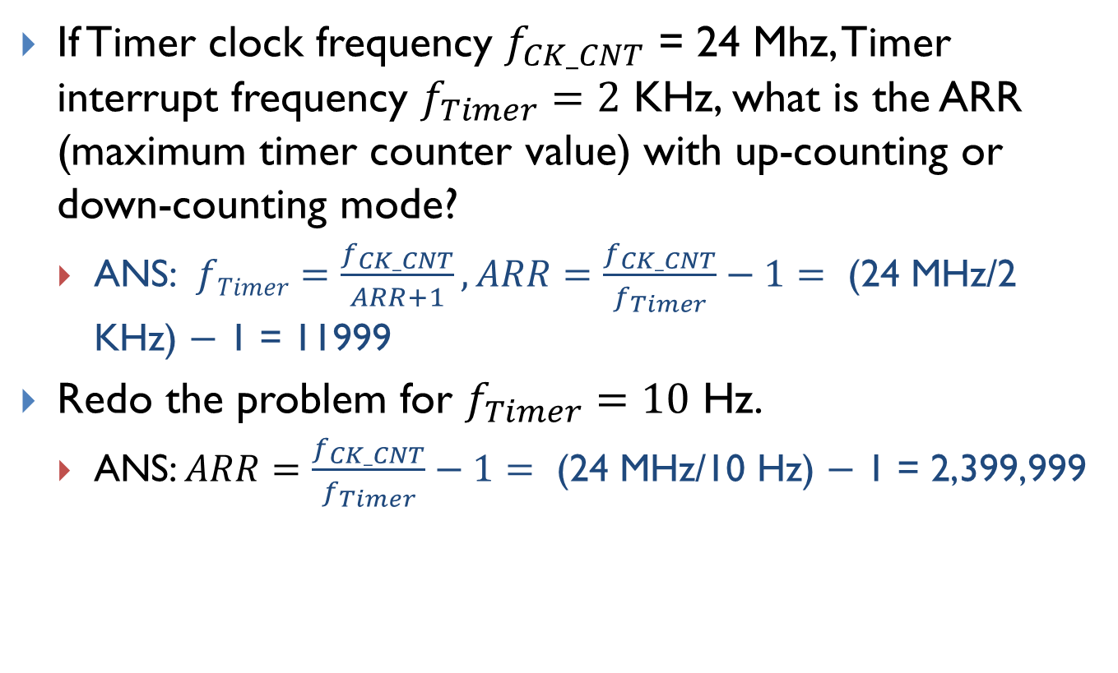
Timer
If Timer clock frequency $f_{CK_CNT}$ = 24 Mhz, Timer interrupt frequency $f_{Timer}=2$ KHz, what is the ARR (maximum timer counter value) with up-counting or down-counting mode?
ANS: $fTimer=\frac{f_{CK_CNT}}{ARR+1}, ARR=\frac{f_{CK_CNT}}{f_{Timer}}−1=\text{ (24 }\text{MHz}\text{/2 }\text{KHz}\text{) − 1 = 11999}$
Redo the problem for $f_{Timer}=10$ Hz.
ANS: $ARR=\frac{f_{CK_CNT}}{f_{Timer}}−1=\text{ (24 }\text{MHz}\text{/10 }\text{Hz}\text{) − 1 = 2,399,999}$
Notes:
12000
2400

Slide 15
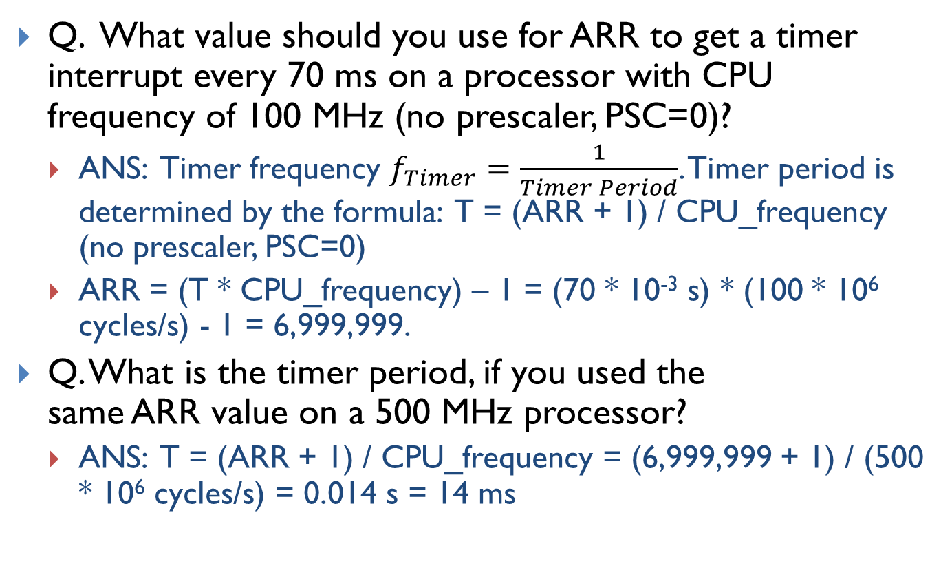
Timer ANS
Q. What value should you use for ARR to get a timer interrupt every 70 ms on a processor with CPU frequency of 100 MHz (no prescaler, PSC=0)?
ANS: Timer frequency $f_{Timer}=\frac{1}{Timer Period}$. Timer period is determined by the formula: T = (ARR + 1) / CPU_frequency (no prescaler, PSC=0)
ARR = (T * CPU_frequency) – 1 = (70 * 10⁻³ s) * (100 * 10⁶ cycles/s) - 1 = 6,999,999.
Q. What is the timer period, if you used the same ARR value on a 500 MHz processor?
ANS: T = (ARR + 1) / CPU_frequency = (6,999,999 + 1) / (500 * 10⁶ cycles/s) = 0.014 s = 14 ms
Notes:
a) What value should you use for ARR to get a SysTick timer interrupt every 70ms on a processor LP1768?
b) If you used the same value for ARR from part (a) but ran that code on a newer microcontroller with CPU frequency of 100 MHz (no prescaler), how often would SysTick interrupts occur?

Slide 16
Interrupt (NOT COVERED)
Suppose register i (i ≤ 12) is initialized to have a value of i (e.g. r0 = 0, r1= 1, r2 = 2, r3 = 3, etc.). Assume the main stack (MSP) is used. (Recall: in the interrupt handler, if LR = 0xFFFFFFF9, then the main stack (MSP) is used. If LR = 0xFFFFFFFD, then the process stack (PSP) is used. ) The program status register (PSR) = 0x00000020, PC = 0x08000020, and LR = 0x20008020, when the interrupt occurs.
(1) Show the stack content immediately before the PUSH instruction runs. Suppose the stack pointer SP, i.e. MSP in this case, was 0x20000600 immediately before the system timer interrupt occurs
(2) What are the values of these registers (R0-R12, LR, SP, PC, and PSR) immediately after the interrupt exits?
SysTick_Handler PROC EXPORT SysTick_Handler PUSH {lr, r0, r7} ADD r0, r0, #1 ADD r1, r1, #1 ADD r2, r2, #1 ADD r3, r3, #1 ADD r4, r4, #1 ADD r5, r5, #1 ADD r6, r6, #1 ADD r7, r7, #1 ADD r8, r8, #1 ADD r9, r9, #1 ADD r10, r10, #1 ADD r11, r11, #1 ADD r12, r12, #1 POP {r0, r7, pc} ENDP

Slide 17
Interrupt ANS
(1)
0x20000600
0x200005FC | 0x00000020 (PSR)
0x200005F8 | 0x08000020 (PC)
0x200005F4 | 0x20008020 (LR)
0x200005F0 | 12 (R12)
0x200005EC | 3 (R3)
0x200005E8 | 2 (R2)
0x200005E4 | 1 (R1)
0x200005E0 | 0 (R0)
0x200005DC

